Slide 1
Architectural Design

Slide 2
Outline
Definition of an Architecture.
Architecture styles :
  Data-centered architectures,
  Data flow architecture
  Call and return architectures
  Object-oriented architectures
  Layered architectures.
Architecture for network based applications
Decentralized architectures

Slide 3
Architecture
SA definition : The software architecture of a program or computing system is the structure or structures of the system, which comprise software components, the externally visible properties of those components, and the relationships among them.
The architecture is a representation that enables you to
  (1) analyze the effectiveness of the design in meeting its stated requirements,
  (2) consider architectural alternatives at a stage when making design changes is still relatively easy, and
  (3) reduce the risks associated with the construction of the software.
Architecture design focus on representation of the structure of software components, their properties, and interactions.

Slide 4
Architecture Styles
An architectural style is to establish a structure for all components of the system.
Each style describes
  (1) a set of components (e.g., a database, computational modules) that perform a function required by a system;
  (2) a set of connectors that enable “communication, coordination and cooperation” among components;
  (3) constraints that define how components can be integrated to form the system; and
  (4) the overall properties of a system

Slide 5
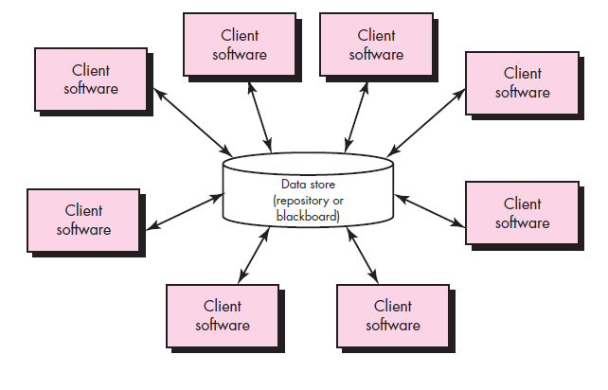
Architectural styles
Data-centered architectures. A data store (e.g., a file or database) resides at the center of this architecture and is accessed frequently by other components that update, add, delete, or otherwise modify data within the store.
Data-centered architectures promote integrability. That is, existing components can be changed and new client components added to the architecture without concern about other clients (because the client components operate independently).

Slide 6
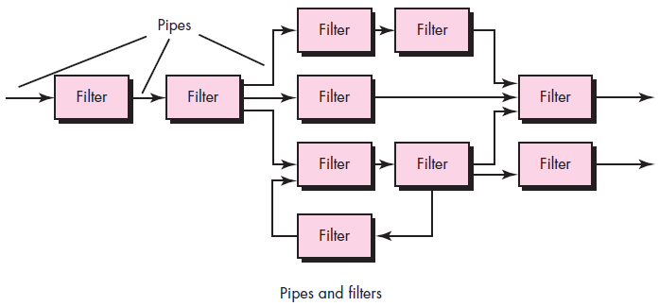
Architectural styles
Data flow architecture : A pipe-and-filter pattern has a set of components, called filters, connected by pipes that transmit data from one component to the next.
Each filter works independently of those components upstream and downstream, is designed to expect data input of a certain form, and produces data output (to the next filter) of a specified form.
However, the filter does not require knowledge of the workings of its neighboring flters.

Slide 7
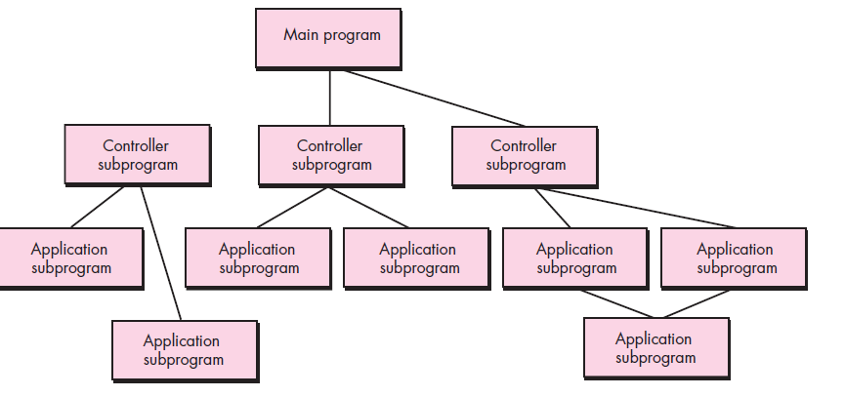
Architectural Styles
Call and return architectures. This architectural style enables you to achieve a program structure that is relatively easy to modify and scale. A number of substyles exist within this category:
Main program/subprogram architectures. This classic program structure decomposes function into a control hierarchy where a “main” program invokes a number of program components that in turn may invoke still other components. Figure illustrates an architecture of this type.
Remote procedure call architectures. The components of a main program/subprogram architecture are distributed across multiple computers on a network.

Slide 8
Architectural Styles
Object-oriented architectures. The components of a system encapsulate data and the operations that must be applied to manipulate the data. Communication and coordination between components are accomplished via message passing.

Slide 9
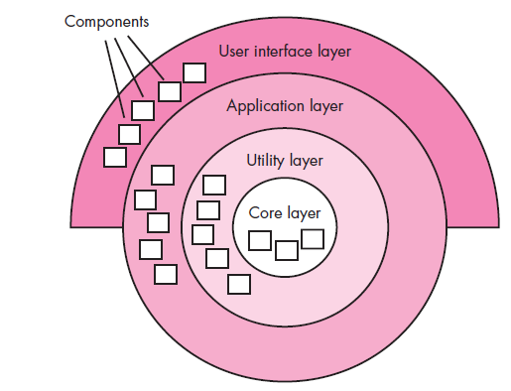
Architectural Styles
Layered architectures. A number of different layers are defined, each accomplishing operations that progressively become closer to the machine instruction set. At the outer layer, components service user interface operations. At the inner layer, components perform operating system interfacing. Intermediate layers provide utility services and application software functions.

Slide 10
Architectural style
Organization and Refinement (detailed analysis of the architecture.) - to establish a set of design criteria that can be used to assess an architectural design that is derived.
Some of criteria to access are as follows:
  How do components transfer control within the system?
  How is control shared among components?
  What is the control topology (i.e., the geometric form that the control takes)?
  Is control synchronized or do components operate asynchronously?
  How are data communicated between components?
  Do data components (e.g., a blackboard or repository) exist, and if so, what is their role?
  How do data and control interact within the system?

Slide 11
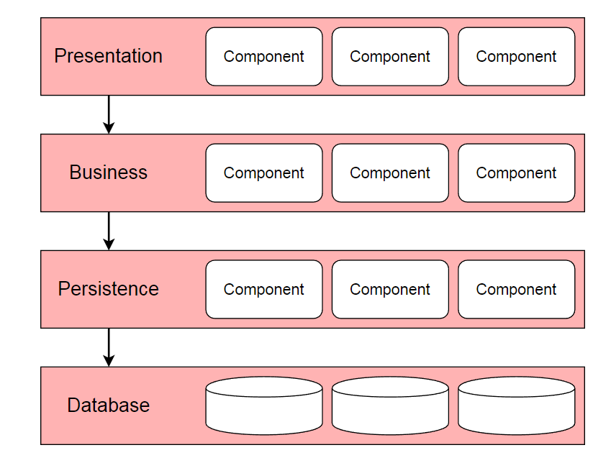
Layered architecture
Is the standard architecture used for most Java Enterprise applications

Slide 12
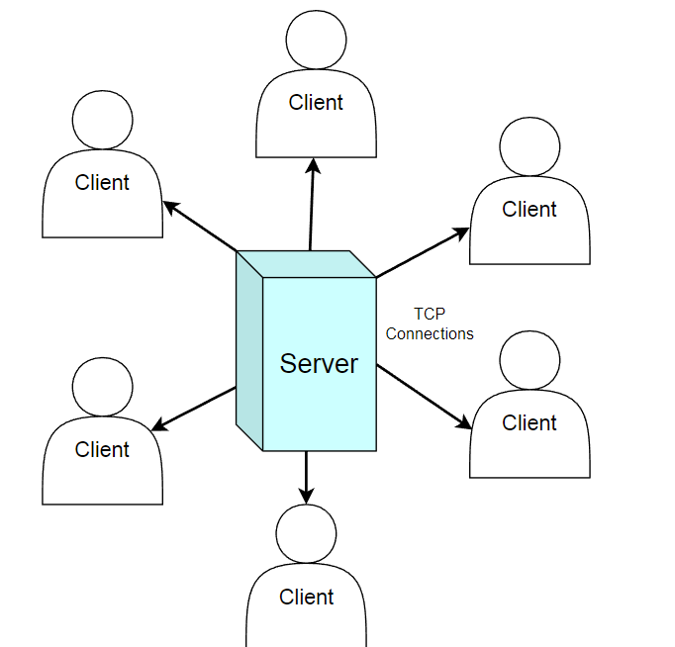
client-server architecture
classic examples of applications with a client-server architecture are the World Wide Web and email.

Slide 13
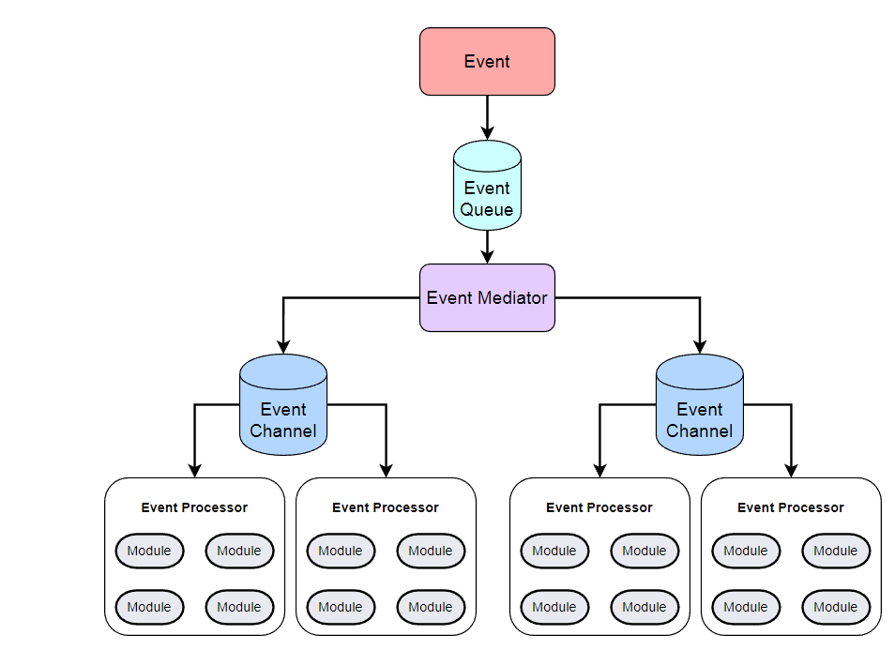
Event-driven architecture
shopping cart on an e-commerce website, swiping of a credit card, Apache Kafka tool

Slide 14
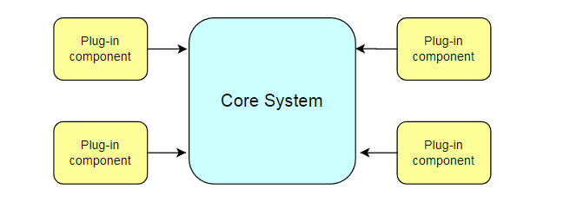
Microkernel architecture
Cold-air intake to your car to boost its torque and horsepower.
2. Plug-in components can be connected using an open service gateway initiative (OSGi), messaging, web services, or object instantiation.

Slide 15
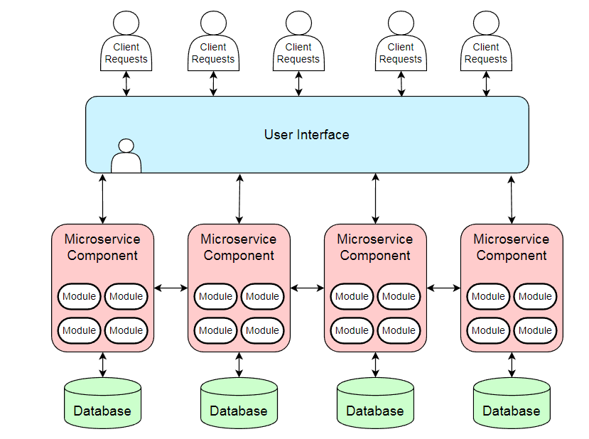
Microservices architecture
Major companies like Amazon, Netflix, and Spotify can be found implementing this architecture.

Slide 16
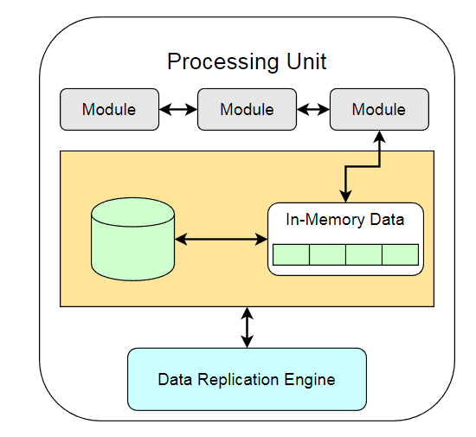
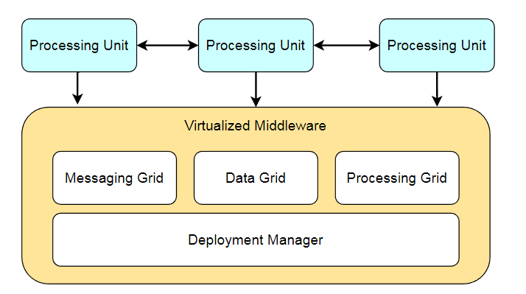
Cloud-native architecture
best for social networking sites or any system that needs to handle massive spikes in traffic.

Slide 17
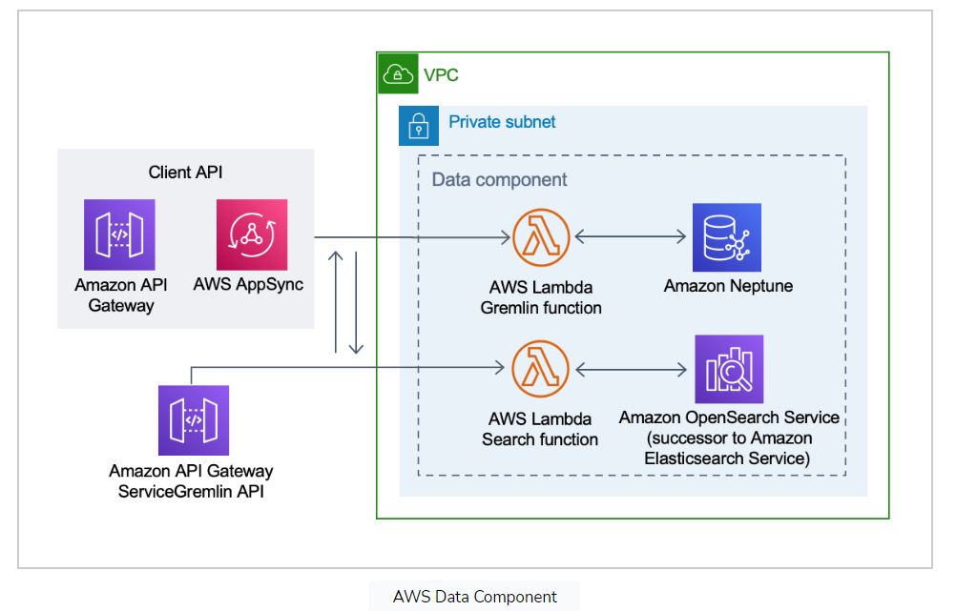
Amazon web services
Amazon Web Services is the most widely used cloud computing platform

Slide 18
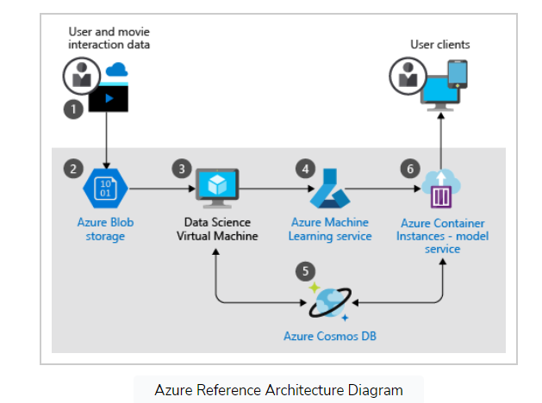
Microsoft Azure
Uses machine learning to create movie recommendations

Slide 19
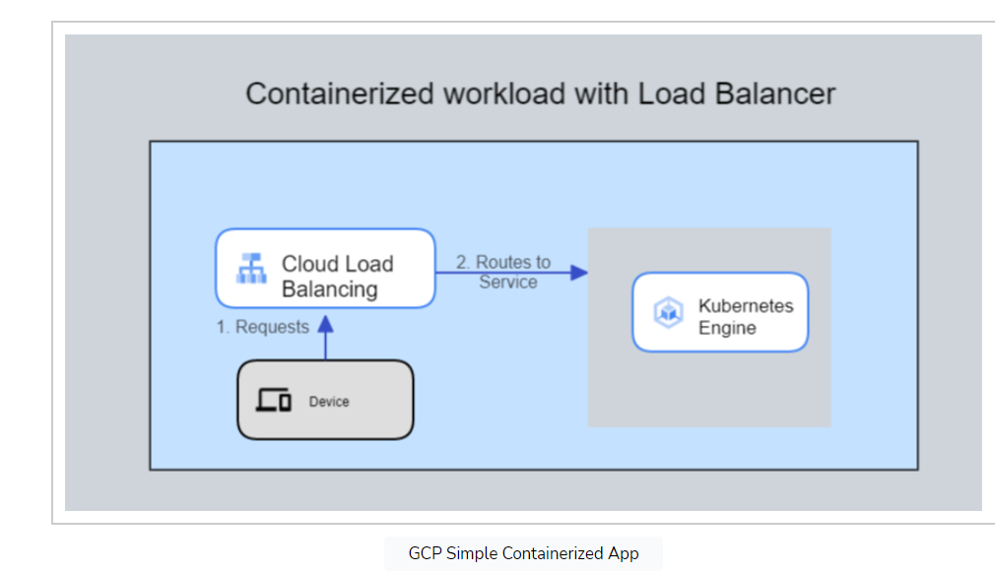
Google Cloud Platform (GCP)
Collection of cloud computing services and the third-largest IaaS provider

Slide 20
Decentralized architecture
A decentralized architecture is one where most of the network functions and resources are distributed among multiple nodes, such as peer-to-peer devices or edge computing devices.
The World Wide Web was originally developed as a decentralized platform.
Blockchain technologies such as Bitcoin and Ethereum are examples of decentralized architectures and systems.

Slide 21
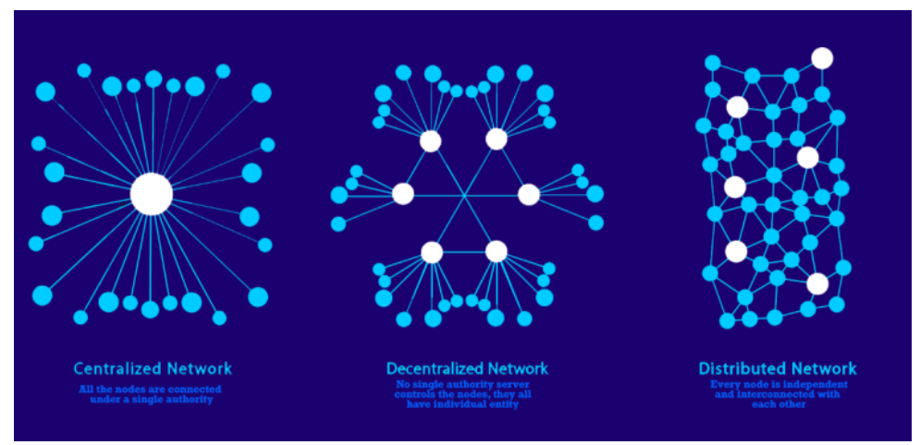
Decentralized architecture

Slide 22
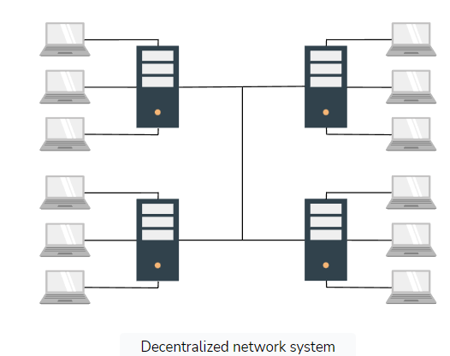
Decentralized architecture

Slide 23
Decentralized architecture
Decentralization is the distribution of functions, control and information instead of centralizing them in a single entity.
Decentralized means that there is no single point where the decision is made. Every node makes a decision for it's own behaviour and the resulting system behaviour is the aggregate response.

Slide 24
Decentralized architecture
This makes it more difficult for hackers to compromise the system and steal sensitive data. Additionally, a decentralized architecture offers greater resilience, as the network can continue to function even if individual nodes fail or drop out. This makes the system more reliable and less prone to downtime.

Slide 25
Decentralized architecture
Features:
  Delegation of authority to lower management.
  Faster response time.
  Quick decision making.
  Development of individual departments.
  Employee engagement and development.

Slide 26
Decentralized architecture
Improved fault tolerance: Decentralized systems are designed to be fault tolerant, meaning that if one or more nodes fail, the system can still continue to function. This is because the workload is distributed across multiple nodes, rather than relying on a single point of failure

Slide 27
Decentralized architecture
The Internet and World Wide Web were conceived as decentralized technologies.
Ethereum is an example of a distributed computing platform and operating system that can run any decentralized application;

